Slide 1
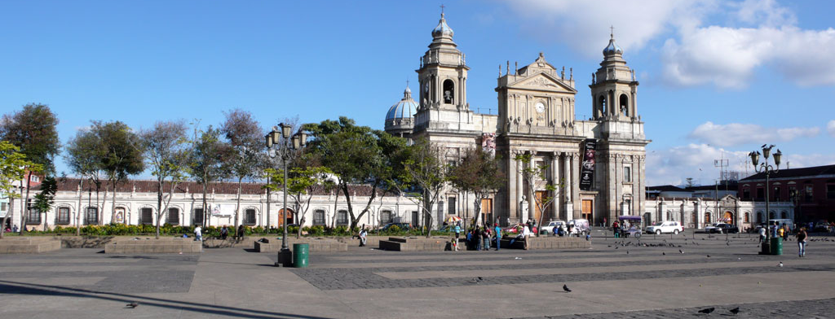
Guatemalan Manuscript Digitization Project
Martha E. Thomae
SIMSSA Workshop XVII
CIRMMT, McGill University
Montreal, December 01, 2018

Slide 2
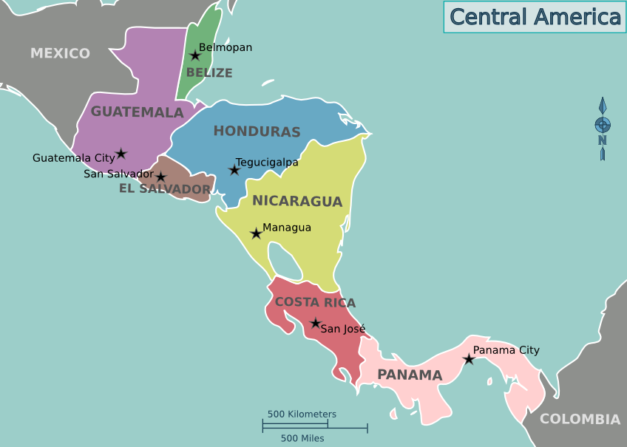
Project Goals
Preservation and dissemination of the musical content of a set of colonial music manuscripts from Guatemala
Using the tools developed at SIMSSA
Pixel.js
Calvo’s method
Interactive Classifier (IC)
Pitch finding
Scoring-up tool
Wikipedia: Central America
Notes:
Goal
Guatemala → country in Central America (just below México)
Part of the Spanish Colonial Empire
Even though colonial music is rooted in the early Western music traditions (e.g., Medieval, Renaissance, and Baroque music), little is known about how these traditions and repertoires evolved in the Spanish colonies of the Americas.
Encode the music content of these manuscripts to preserve it and make it accessible outside of the country to allow for studying things like this.
Do it using …

Slide 3
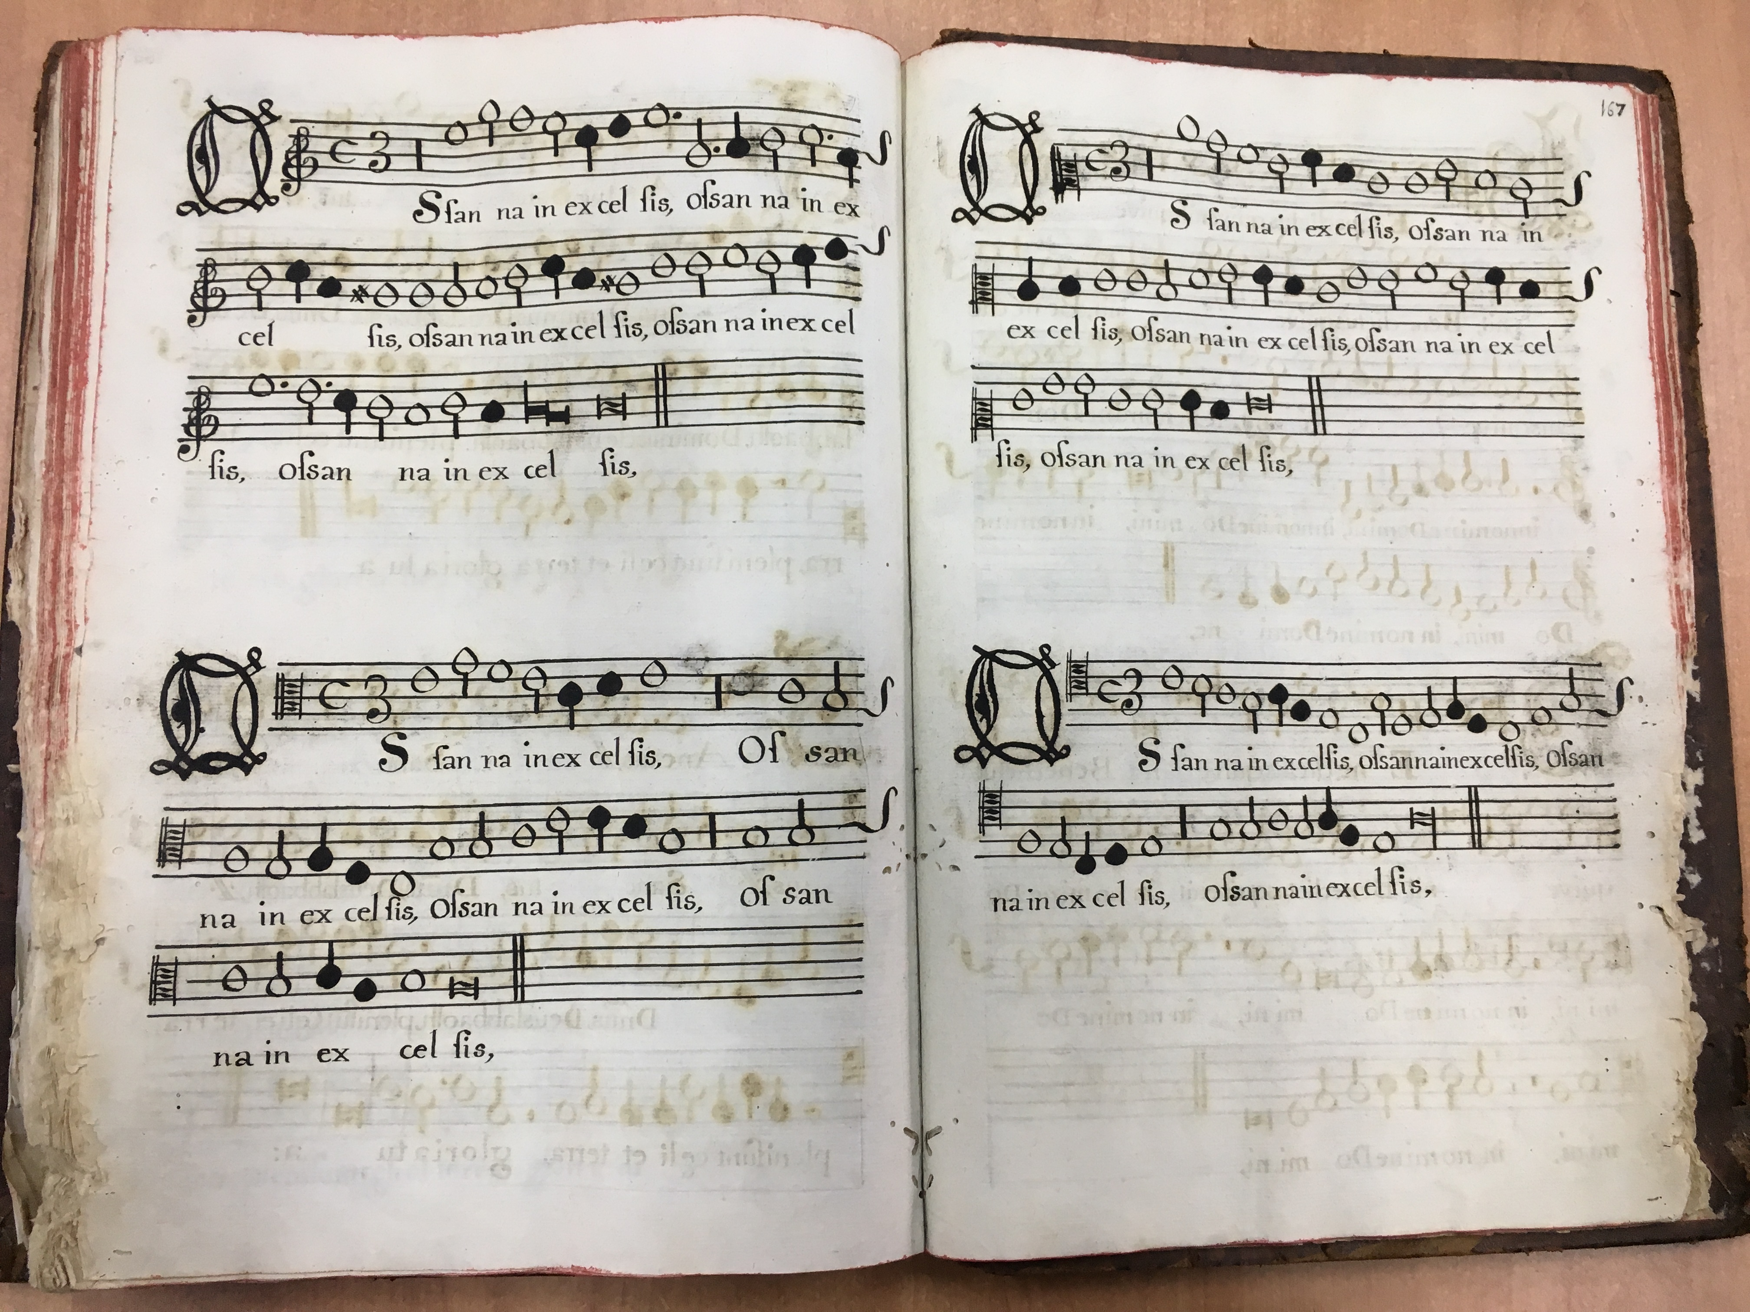
Guatemalan Manuscripts
Copied between XVI - XVIII
Choirbooks
Written in mensural notation
Music notation system used in Europe throughout the Late Middle Ages and the Renaissance
Notes:
The notation used in these choirbooks is similar to the one used during the Renaissance.

Slide 4
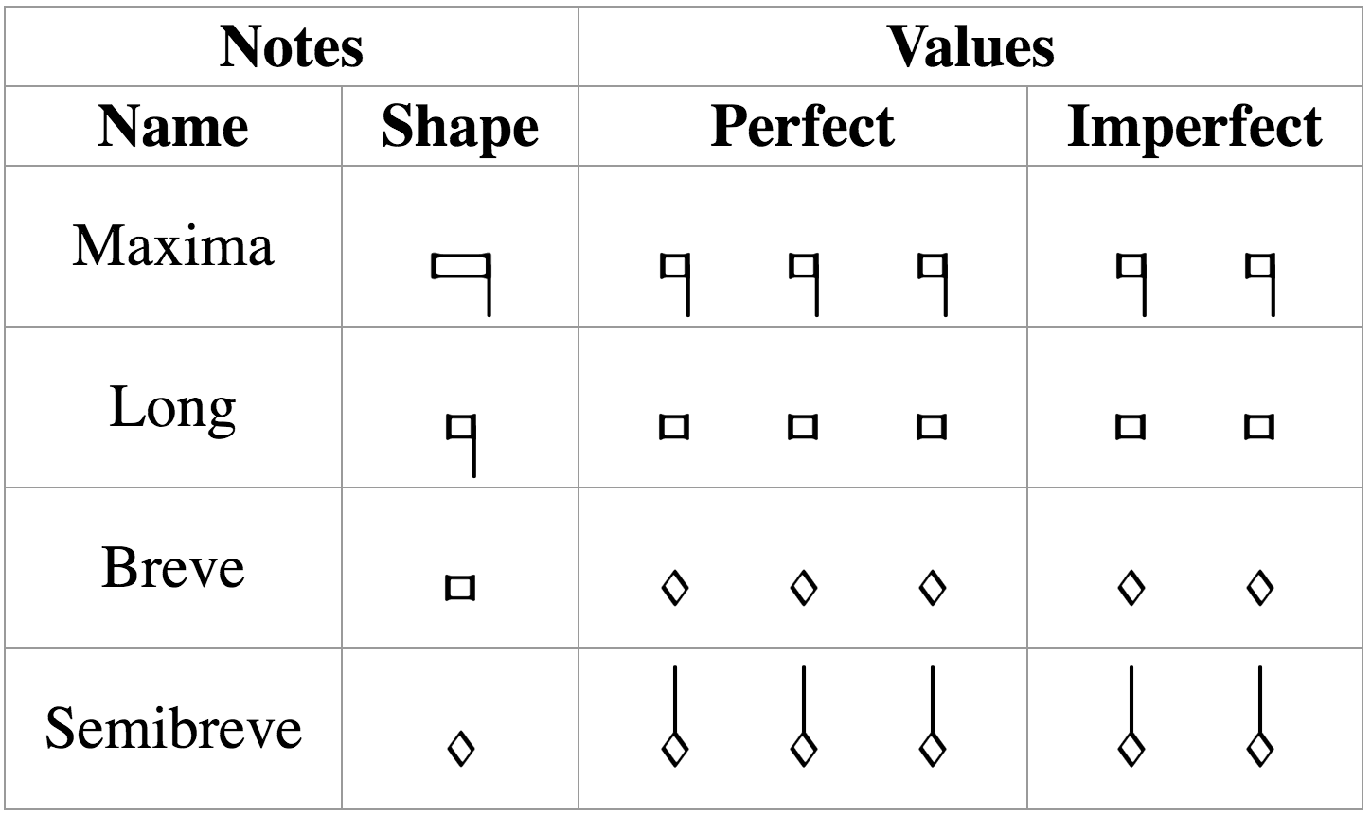

Mensural Notation
mensuration
longest
shortest
3 x 2 x 1 x 3 x
Notes:
MENSURATION & Context
The note shape is not enough to determine the note duration.

Slide 5
Barriers for Accessing the Music
Lack of high-quality digital images
Notation style (mensural notation)
Layout (choirbook format)
Notes:
Preserve and DISSEMINATE the MUSIC CONTENT of these manuscripts
ISSUES
Microfilms (1970s by Robert Stevenson) --> images are cropped on top and bottom
Digitized into DjVu files (without permission) --> bad quality (missing images between files)
Expert to interpret it
Know how the piece sounds like --> 4 experts singing each voice
OR 1 expert to transcribe the piece into a score
IT IS EVEN DIFFICULT FOR THE EXPERT
SO THE IDEA IS REMOVING THESE ACCESIBILITY BARRIERS, USING THE TECHNOLOGIES DEVELOPED HERE AT SIMSSA

Slide 6
SIMSSA Tools
Document Segmentation
(Pixel.js & Calvo's Method)
Optical Music Recognition
(Interactive Classifier)
Pitch
Finding
Correction
Scoring-up Tool
Music symbols
Pitch
OMR Workflow
Notes:
The note shape is not enough
We need the “duration”
Append this TOOL at the end → the Scoring-Up Tool → WHICH I DEVELOPED FOR MY MASTER’S THESIS
Last two accessibility issues: notation and format

Slide 7
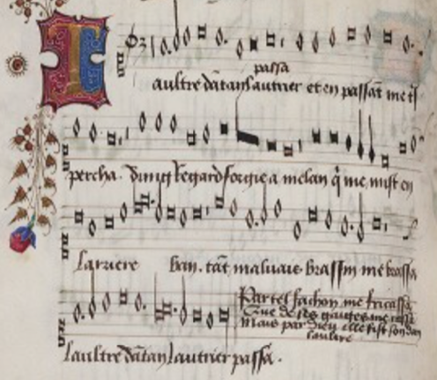
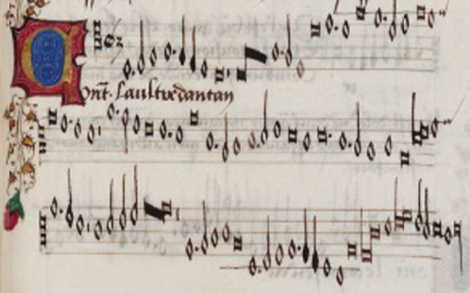

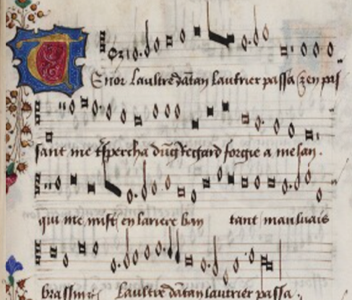
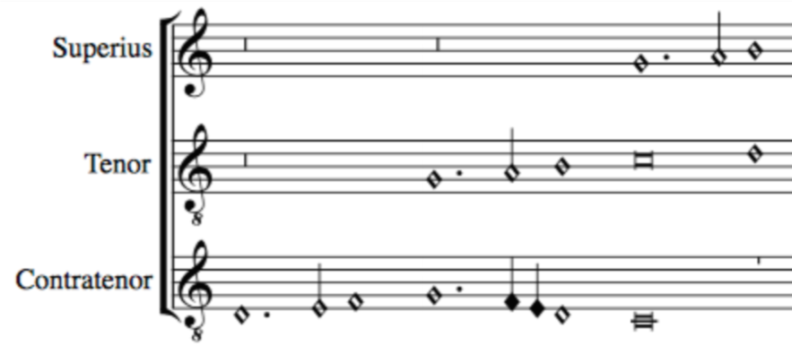
Pitch
Note shape
Mensural MEI file
_______
_______
Scoring-up
Tool
Duration based on context
Merge all files together
OMR
Mensural
MEI file
________
________
________
________
Superius part
OMR
Mensural MEI file
_______
_______
Contratenor part
SCORE
Mensural MEI file
_______
_______
OMR
Tenor part

Slide 8
SIMSSA Tools
Digitization
(DIY Book Scanner)
Document Segmentation
(Pixel.js & Calvo's Method)
Optical Music Recognition
(Interactive Classifier)
Pitch Finding
Correction
Scoring-up Tool
OMR Workflow
Notes:
general omr workflow
we need digital images
prepend digitization step:
- Antiquity --> no flatbed scanner
- Book Scanner
-> NO approp. for the large dimensions of the books
buying is not an option --> DIY
[NEXT SLIDE]

Slide 9
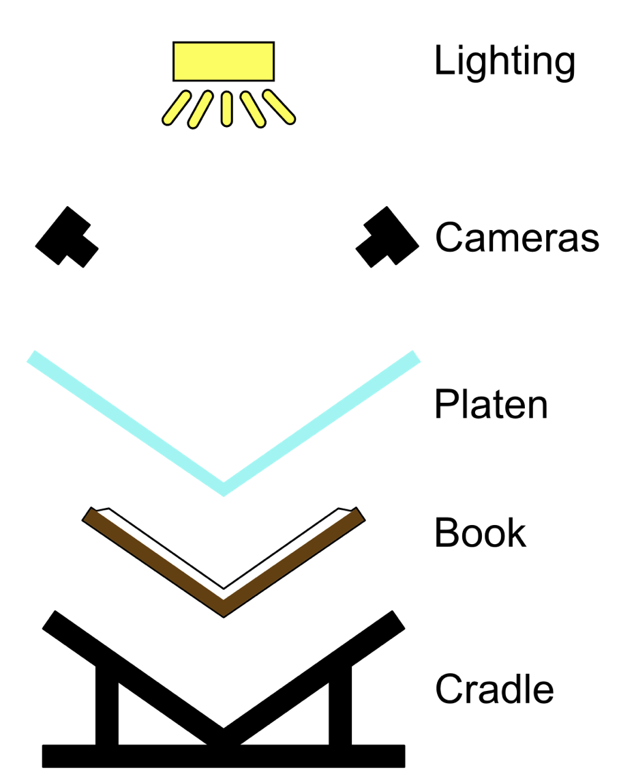

DIY Scanner
DIY Book Scanner

Slide 10
Expected Results
Digitization
Document Segmentation
Optical Music Recognition
Pitch Finding
Correction
Scoring-up Tool
Digitization and encoding of the repertoire as musical scores in a machine-readable file format
Facilitate its preservation, dissemination, study by musicologists, and appreciation by the general public
We expect this research to be used as a model for the digitization of the mensural repertoire of other countries that were once part of the colonial past
Notes:
Musical content encoded as scores
more familiar format for modern musicians
encoded --> play it back
score --> vertical sonorities (contrapuntal studies)
ACCESS both INSIDE and OUTSIDE Guatemala

Slide 11



Thank you! martha.thomaeelias@mail.mcgill.ca

